Slide 1
Welcome to Pediatric Emergencies Bootcamp!
Speakers
  Mimi Lu, MD
    Pediatric EKGs
  Dina Wallin, MD
    Pediatric fever
  Carol Chen, MD MPH
    Pediatric pain management and anxiolysis

Slide 2
Welcome to Pediatric Emergency Medicine Learning Lab!
Hand-outs
  Information sheet (one page) – for you to reference during session
  Cases to discuss during small groups (3 topics)
Schedule
  Lectures
    13 minutes each; hold questions for small groups
  Small groups (3 tables)
    25 minutes per group; 1 minute for SPEAKERS to rotate btw groups

Slide 3
Pediatric Pain Management and Anxiolysis
Carol C. Chen, MD MPH
Associate Clinical Professor of Emergency Medicine and Pediatrics
Medical Co-Director of Pediatric Emergency Medicine, Zuckerberg San Francisco General Hospital & Trauma Center
Child Injury Prevention Lead, Department of Emergency Medicine
University of California San Francisco
Notes:
Good morning everyone, my name is Carol Chen and I am one of the pediatric emergency medicine faculty at UCSF.
Today I am going to talk to you about pediatric pain management and sedation. This lecture has a lot of information packed into it, but don’t worry, we will have time during the small group to practice some of these principles.

Slide 4
Disclosures
I have no disclosures.

Slide 5
Goals
Characterize the approach to managing pain and anxiety when performing common procedures on children in the emergency department
Describe some tips and tricks specific to pediatric analgesia and anxiolysis in the emergency department
Notes:
I have 2 primary goals for this lecture.
To talk about the general approach to managing pain and anxiety in children in the context of performing common procedures in the emergency department.
And to describe some pediatric-specific tips and tricks

Slide 6
Objectives
By the end of this lecture, participants will be able to:
  Describe two scales used to assess acute pain in infants and children.
  List at least three non-pharmacologic methods to manage anxiety and pain in children.
  Name three topical analgesic agents commonly used in children.
  Explain how to blend pharmacologic and non-pharmacologic methods of anxiolysis and analgesia to successfully carry out the following common procedures in children:
    Peripheral intravenous catheter (PIV) placement
    Laceration repair
Notes:
By the end of this lecture you should be able to:
Describe pediatric-specific pain scales.
List some non-pharmacologic methods for managing pain and anxiety in children.
Describe some topical analgesic agents that are commonly used in children in the ED.
Talk about how to blend pharmacologic and non-pharmacologic methods to successfully perform a PIV placement and simple laceration repair in a child.

Slide 7
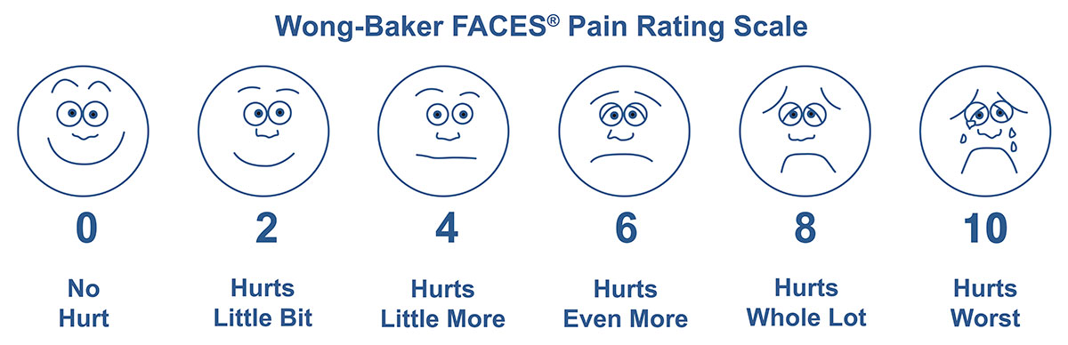
Assessing Acute Pain in Children
Self-report pain scales are the best indicators of pain in children > 3 years and those able to report pain
Notes:
Self-reported pain scales are the best to assess pain in children older than 3 years
The Wong-Baker FACES scale is one of the most popular, however there isn’t a lot of data supporting the use of this faces scales over other faces scales
For older children and adolescents (> 7 years old), the use of a visual analog scale, usually spanning from 0 to 10 is the most reliable

Slide 8
Assessing Acute Pain in Children
Notes:
For infants and children < 3 years of age, you may recognize the revised FLACC scale, which is an observational scale
You can see that it takes into account things like tone, activity and consolability
To be honest, in this age group, I rely heavily on the power of the parents and their tendency to know their children well; this is especially helpful in older children who are developmentally delayed

Slide 9
Case 1
  6yo healthy child
  Vomiting and diarrhea x 3 days
  + sick contact in sibling w same symptoms
  HR 155 BP 100/63 RR 20 T 37.4 100% RA
  Tired appearing; answers your questions appropriately, NAD
  Tacky mucus membranes, dry lips
  Abdomen benign
  Capillary refill 2-3 seconds

Slide 10
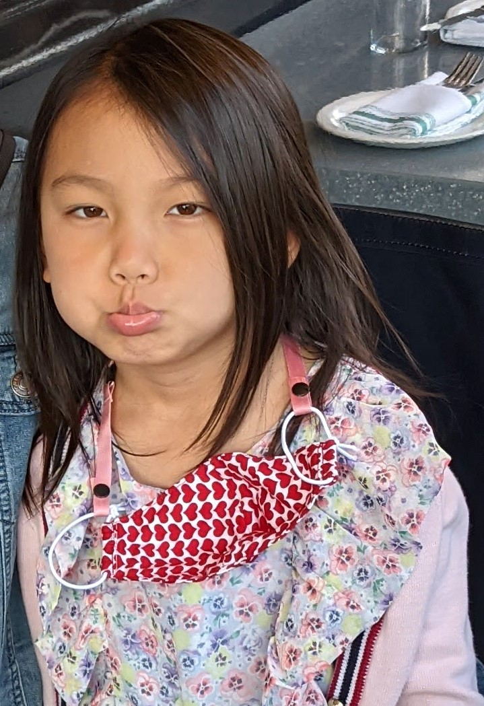
Case 1 (cont’d)
  A+P: Mild dehydration in the setting of a likely acute gastroenteritis.
  ondansetron and oral challenge
  Vomits about 5 minutes after taking the ondansetron.
  Plan is to place a PIV and give fluids.
  Child overhears you and starts crying.
Notes:
You are informed by her nurse that she vomits about 5 minutes after taking the ondansetron. The nurse comments, “She looks really dry”. You decide to place a PIV and give fluids.
You inform the Father who is agreeable with the plan. The child overhears you and starts crying. “What are you going to do? Is it going to hurt?”, she asks you.

Slide 11
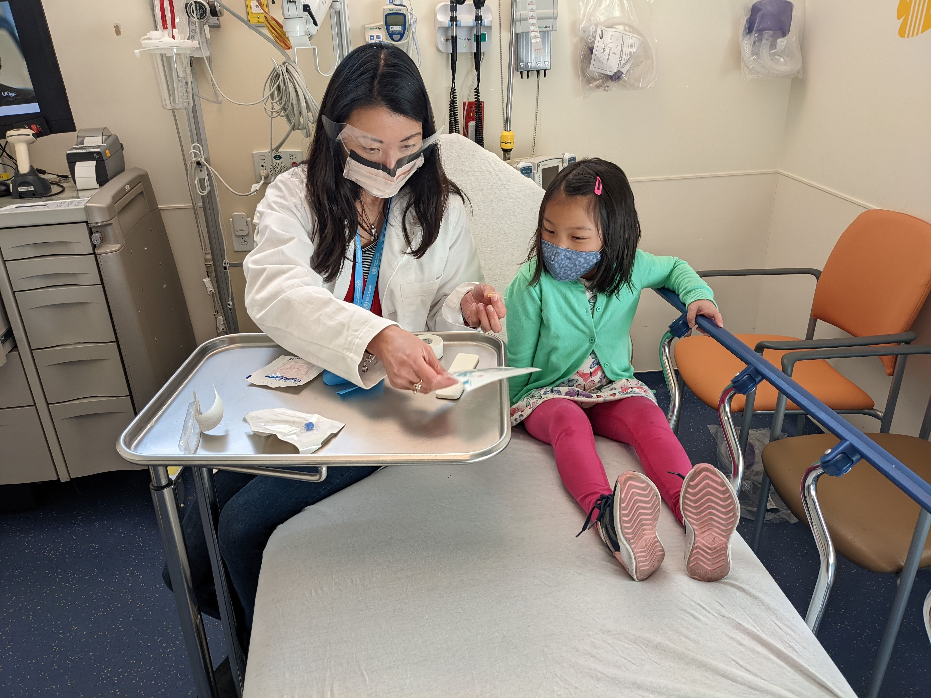
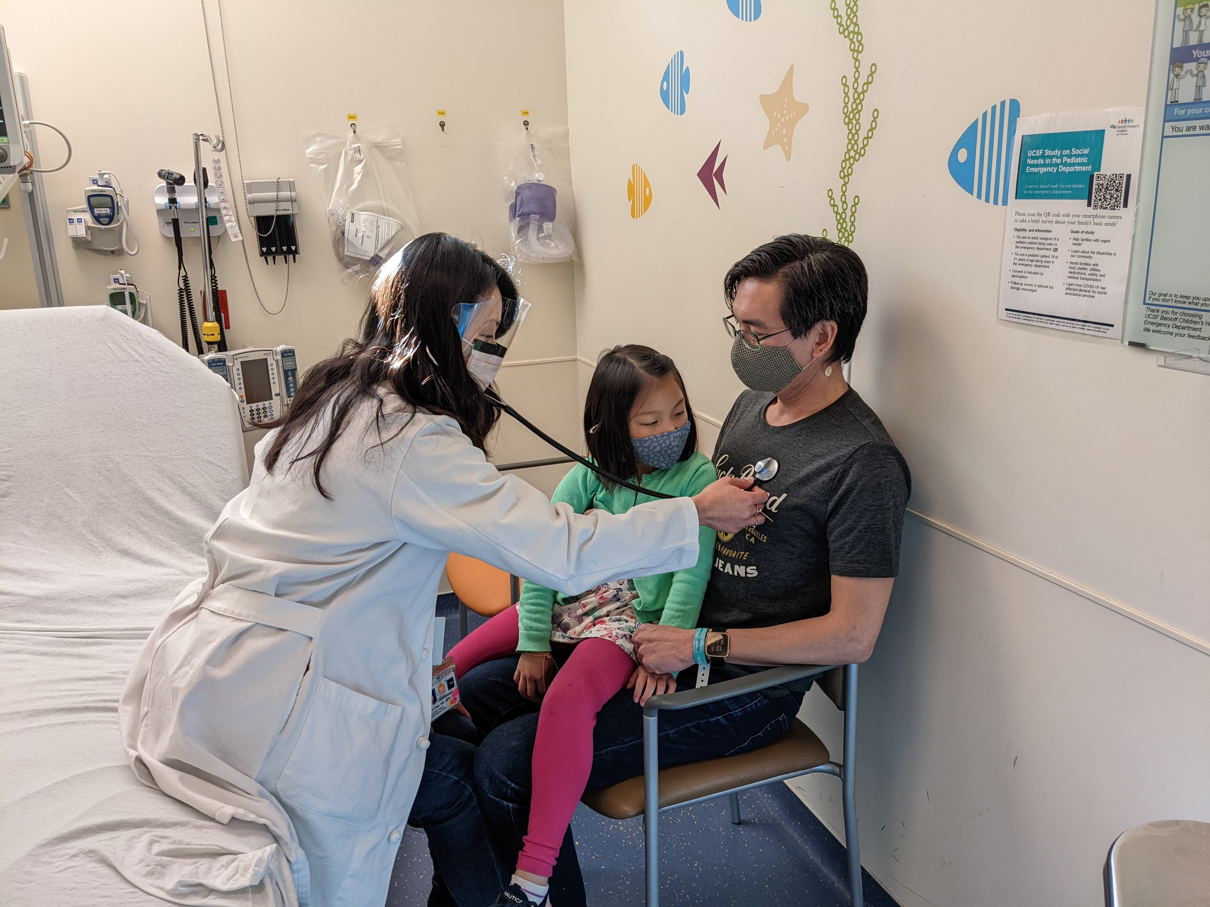
Case 1 - Where to begin?
  Verbal versus pre-verbal children
Notes:
With verbal children, especially like this child who is early school age, you can explain the procedure to them and show them the “straw”, or PIV, that will be used.
But also keep in mind that at this age, their imaginations are really active, so you don’t want to have a long lag period between when you explain the procedure and when you perform it. It’s the anticipation that will kill them!
With pre-verbal children, this may not be an option. And anxiety or fear often intensifies the pain.
However, don’t forget that for non-painful procedures in this age group, like when performing a physical exam, you can still allay some of their fears by first performing the exam on the parent or caregiver, as shown in the photo on the right. This is obviously not an option in this case b/c we are placing an IV, but something to remember for non-painful procedures.

Slide 12
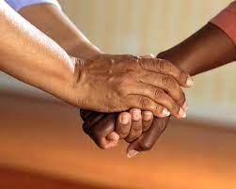
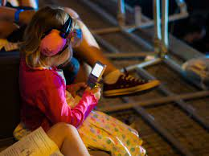
Non-pharmacological Pain Control in Children
Physical contact is critical.
Distraction is king.
Deep breathing or counting can help with anxiety.
Notes:
Next, let’s consider some simple, non-pharmacologic ways that ED staff can provide pain control for painful procedures in children.
I’ve provided a list in your handout so I won’t go through each one in detail however I wanted to highlight a few unifying principles:
Physical contact between the child and their caregiver or support person is really important for almost every aspect of their visit, from triage all the way through to disposition.
Distraction is king, whether it’s through toys, music, videos, or even conversation, like asking the child to talk about their favorite activity.
Finally, deep breathing or counting can help calm younger children, decreasing the impact on anxiety on their pain.

Slide 13
What you need to know to choose an analgesic
Procedure
Expected pain severity
Expected pain duration
Required duration of immobility
Distressful or frightening appearance of procedure
Patient
Current pain rating
Prior experiences
Developmental age
Initial reaction to provider
Parental expectation
Agent
Onset
Duration
Desired effects
Unwanted effects
Notes:
What else could help us in this situation? Let’s think about how to choose an appropriate analgesic.
We need to consider 3 main things:
Characteristics of the procedure itself, including how painful we expect it to be and how long we expect that pain to last
Patient factors, such as their developmental age and any prior experiences with similar, painful procedures; you can also take into account how they react to you when you first walk into the room
And lastly we need to consider the properties of whatever analgesic agents we are thinking of using, including how fast they work, how long they last, and any side effects
This child is likely no stranger to needles (hello, vaccines) anything sharp will be distressing for her. But we are talking about PIV placement, so we can expect it to be quick with a short duration of immobility needed. So either something not too strong but also likely to last a bit longer, or perhaps something a bit stronger but very quick, and delivered in a way that doesn’t cause more distress than the procedure itself.

Slide 14
Specific Analgesics
Mild pain
Ibuprofen
Acetaminophen
Sucrose
Notes:
So what are some of our options?
I am going to break this down into treating mild and moderate to severe pain.
So for mild pain, agents that we are all familiar with include ibuprofen and acetaminophen
Generally, you will using sucrose in infants only.

Slide 15
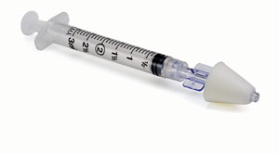
Specific Analgesics
Moderate to severe pain
Intranasal fentanyl
  1.5 – 2 mcg/kg (max 100 mcg)
  Volume limited (1mL per nostril)
  Onset of action 1 – 2 minutes
Notes:
Agents for moderate to severe pain will generally include your narcotics which most of us are familiar with, but I wanted to highlight an agent that we use quite often in the pediatric population, which is intranasal fentanyl.
The dose of IN fentanyl is typically 1.5 – 2 mcg/kg up to a maximum of 100 mcg. Your maximum dose may be limited by volume as you can only give up to 1mL in each nostril; less for smaller children.
Has to be instilled using an atomizer
Onset of action 1-2min
It has been shown to be as effective as morphine for children with long bone fractures and does not require administration of an IV

Slide 16
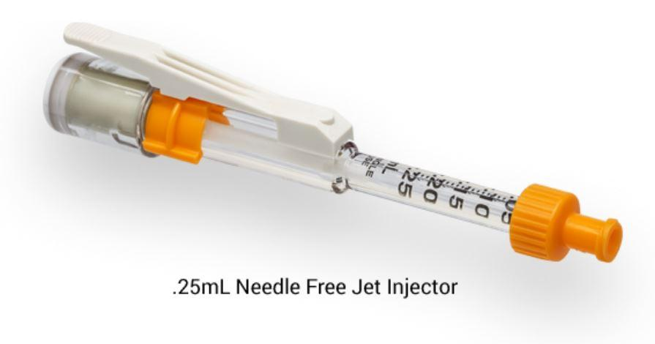
Specific Analgesics
Topical
Notes:
In terms of topical analgesics, the most common ones we use are LET and either EMLA or LMX
what’s the difference? LET is used on open wounds and LMX or EMLA is typically used on intact skin
If the liquid formulation is used (as you can see it is also available in a gel formulation), LET needs to be applied with a cotton ball rather than gauze for most potent effect
Onset of action is about 30 minutes
The biggest differences between EMLA and LMX are that EMLA takes 60 minutes to work and LMX takes about 20 minutes, and the fact that LMX does not contain prilocaine so does not increase the risk for methemoglobinemia in neonates
J-tips are what we using most often with older children for IV starts now. It delivers intradermal lidocaine using pressurized gas so no needles are involved. Studies have shown good efficacy however younger children are often frightened by the loud noise that accompanies the delivery of the lidocaine. It’s onset of action is very quick, 1-3min, so it is a great option for IV starts and blood draws.

Slide 17
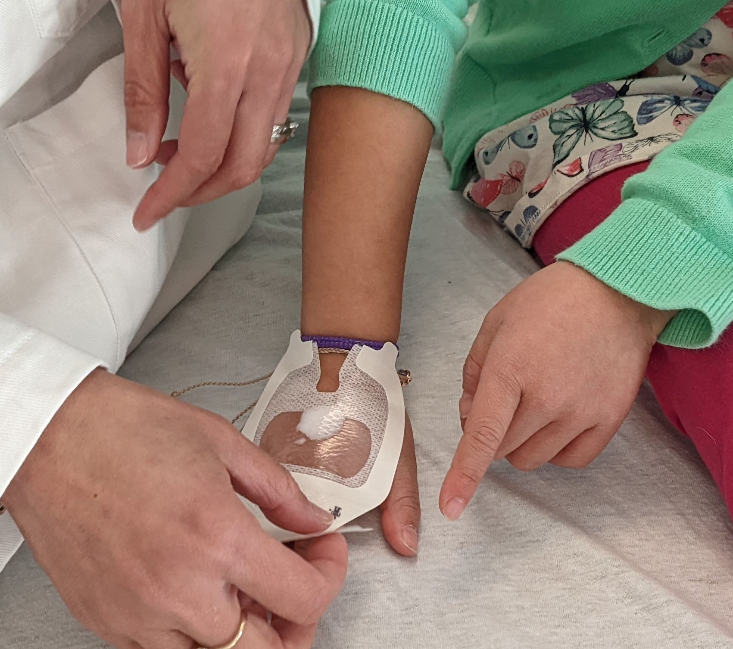
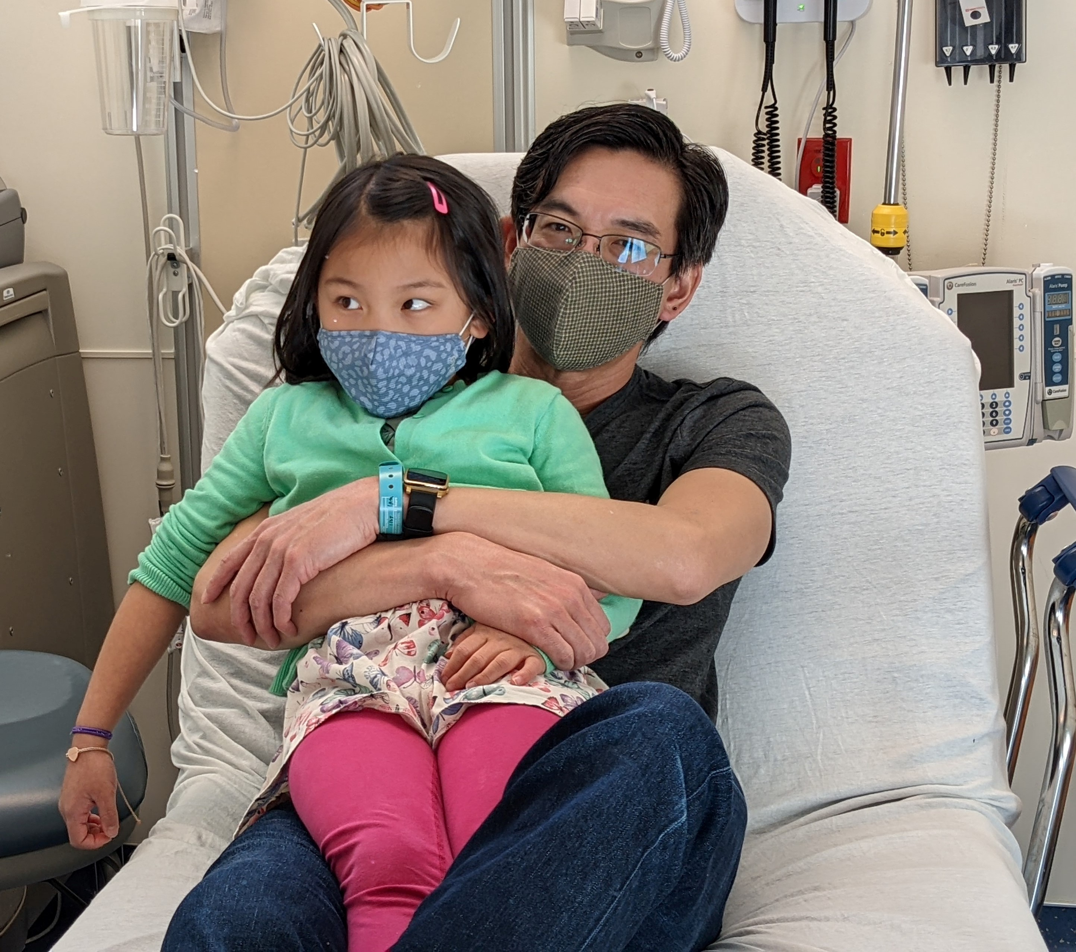
Case 1 - What did I decide?
    Preparation
Notes:
I discussed the option of J-tip with the father but he thought the loud noise would scare his daughter more, so you decide to use LMX for topical analgesia to place to IV.
When it is time to perform the procedure, I instruct the father on how to hold his daughter in a comfort hold, as shown here in this photo. Note how placing the child in the father’s lap allows him to hold her arms and torso firmly. He is also able to control her legs by tucking them underneath his own.

Slide 18
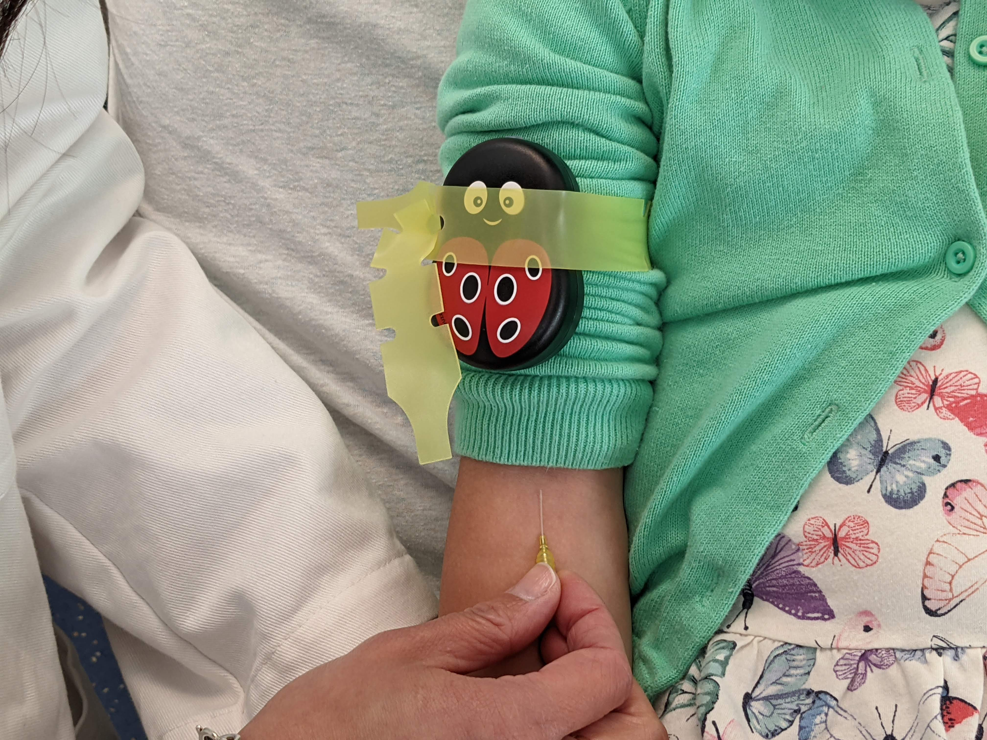
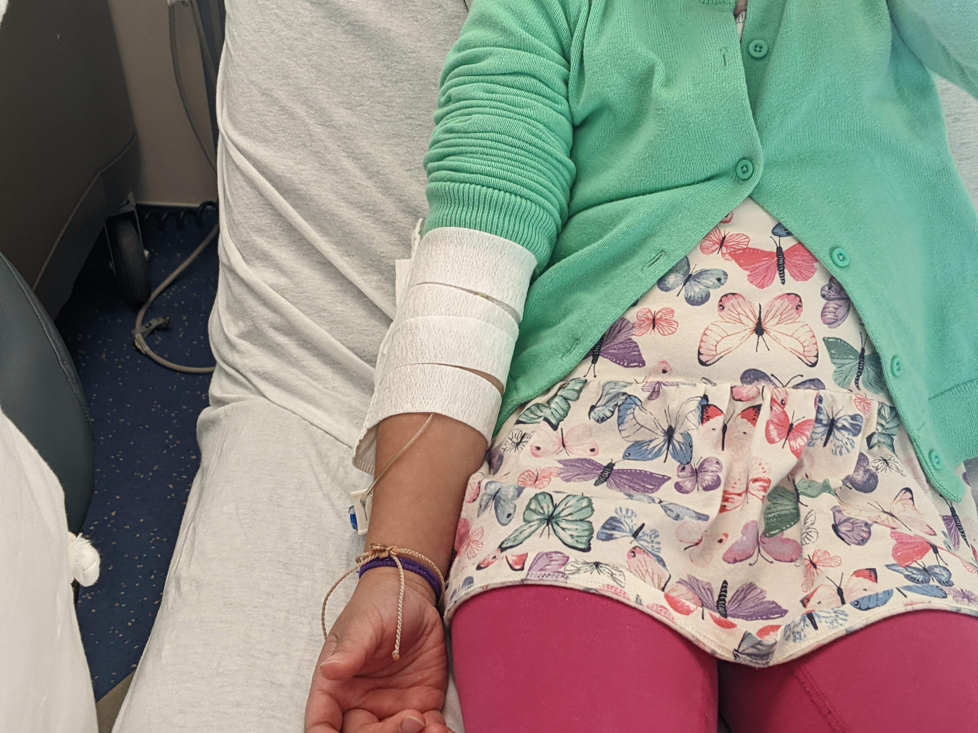
Case 1 - What did I decide?
    Go time
Notes:
I use a Buzzy Bee as a distraction technique while placing the actual IV. If you haven’t tried one of these before, it is a really great investment - $40 to $50 on Amazon. The bee vibrates, providing a tactile distraction. It also comes w a gel pack that can be frozen and placed directly under the bee to provide additional analgesia.
Once the IV is in, you smartly secure it with an arm board to prevent losing it.

Slide 19
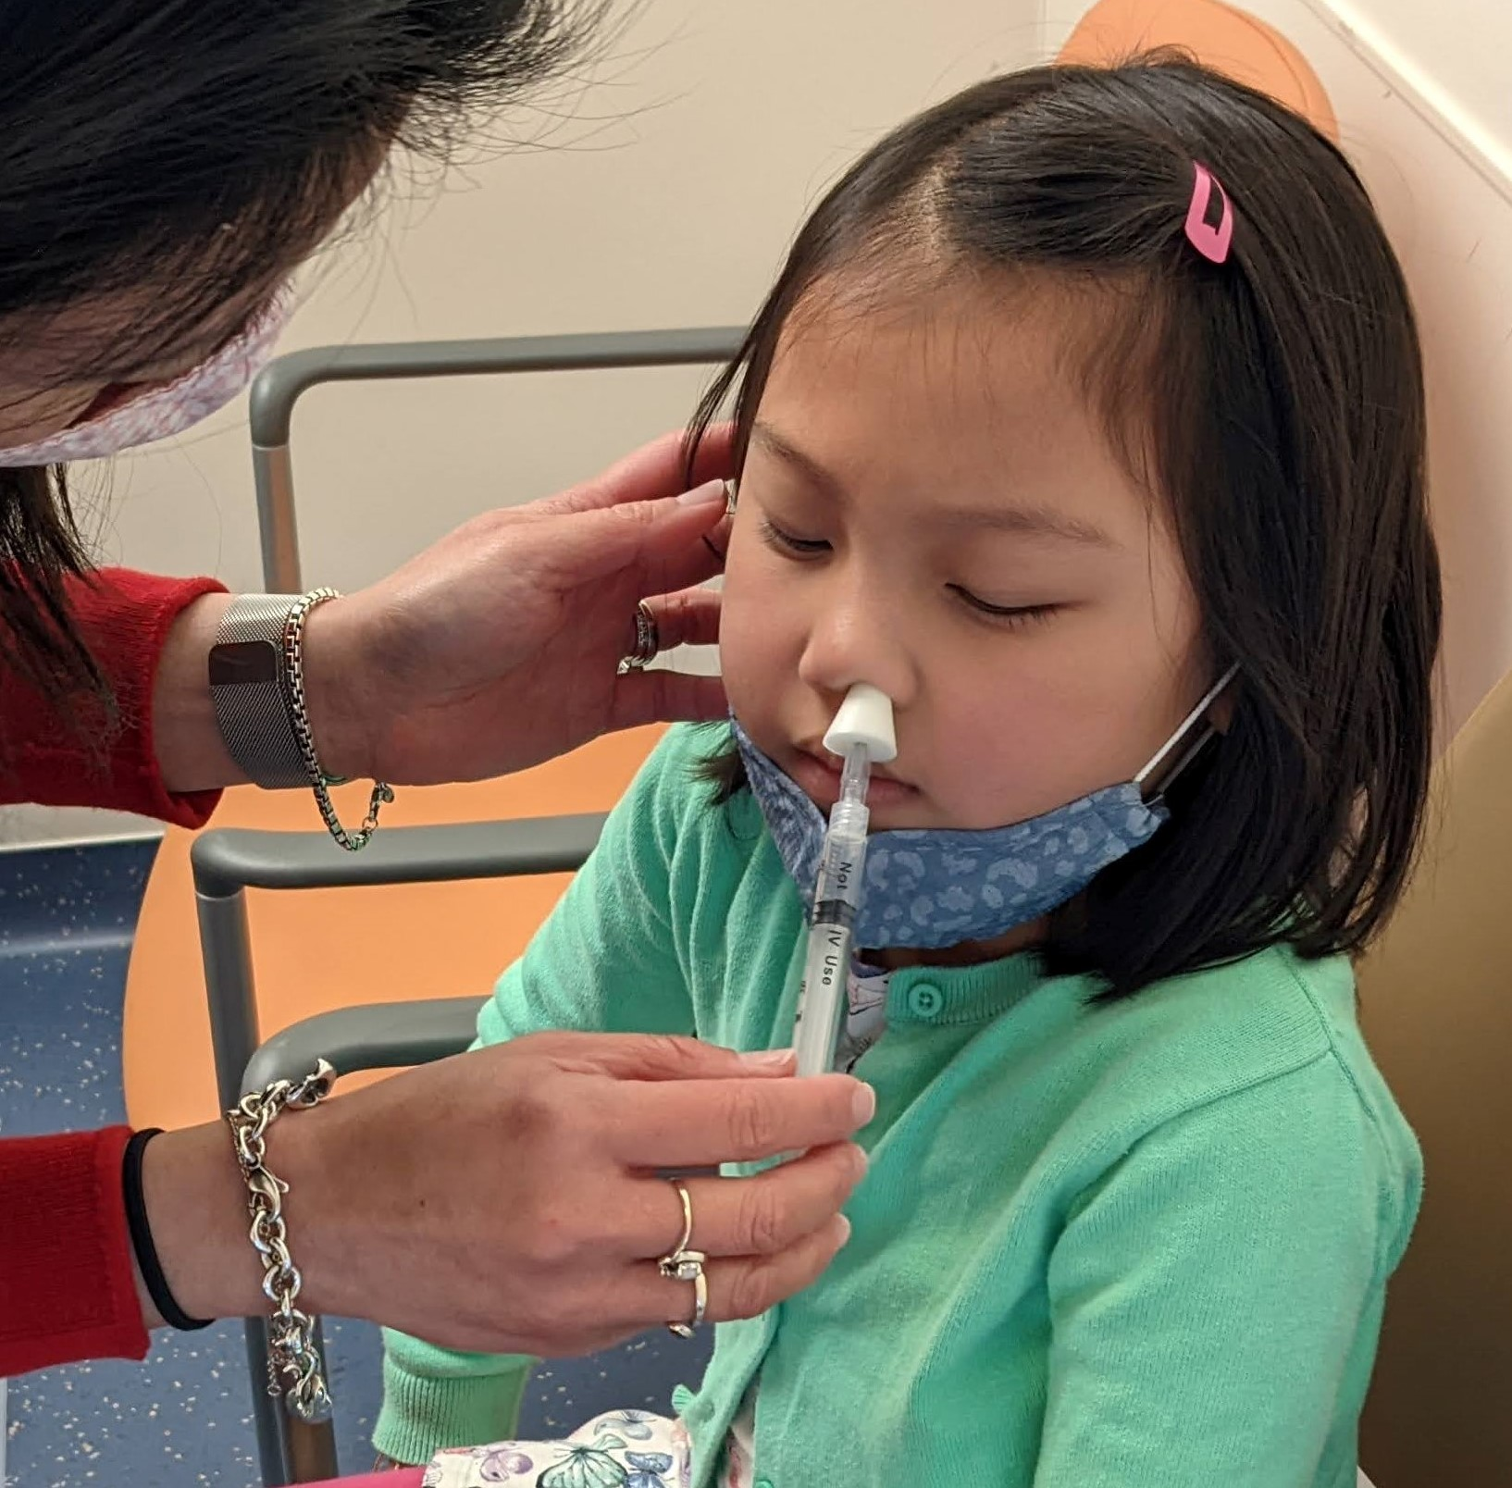
Case 1 - Under what conditions would I consider something stronger?
Midazolam | Dosing | Onset of Action
Intranasal | 0.4 – 0.5 mg/kg, max 10 mg | 10-15 minutes
Oral | 0.4 – 0.8 mg/kg, max 20 mg | 20-30 minutes
Precedex | Dosing | Onset of Action/ Duration
Intranasal | 2 mcg/kg -> 1 mcg/kg in 20min | 30-40 minutes 40-100 minutes
Notes:
One question that often comes up with IV placement (or bladder catheterization) in kids is when I would consider using something stronger, like an anxiolytic medication to assist the procedure.
Generally speaking I would say that I would consider it when it’s needed for the safety of the patient, the parent, or any staff. Now, most 6-year olds are going to put up a fight when you try to poke them with a needle, but most can also be safely approached with a comfort hold and distraction techniques.
However, if you have a larger, extremely combative child, especially one who is unable to understand or follow instructions, then an anxiolytic may be necessary to safely complete the procedure. In those cases, I would consider 2 options: midazolam (either oral or intranasal) or intranasal dexmedetomidine.
The dose of midazolam I generally use is 0.4 -0.5 mg/kg. While you will see starting doses of 0.2mg/kg, this is typically too low to achieve the effect that you want.
To deliver it intranasally, you need an atomizer to attach to the syringe to spray it up the nose, which is shown in this photo.
It takes about 10-15 minutes to see effects.
Unlike intranasal fentanyl, midazolam does sting when going into the nose, so you will notice that most kids will have a reaction to its administration.
Oral midazolam is another great option if you do not have the ability to give it intranasally; or even if you do! The onset of action is a bit slower at 20-30 minutes, but it also does not have the unpleasant stinging sensation when administered. I often use this in older children, but you can also use it in toddlers who will take oral meds but may not tolerate the stimulation of the intranasal medication.
Intranasal dexmedetomidine is a somewhat newer medication that we are offering in our pediatric emergency departments now. There are several published studies in pediatrics demonstrating it’s safety and efficacy. Our protocol is shown here.

Slide 20
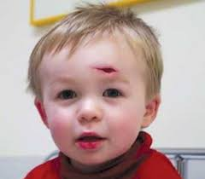
Case 2
  4yo healthy child
  Forehead laceration after tripping and falling at home
  No other concerning historical elements
  PE: 2cm, gaping forehead laceration
  A+P: Suture repair of laceration
Notes:
After much discussion with the mother, I agree on a suture repair of the laceration.

Slide 21
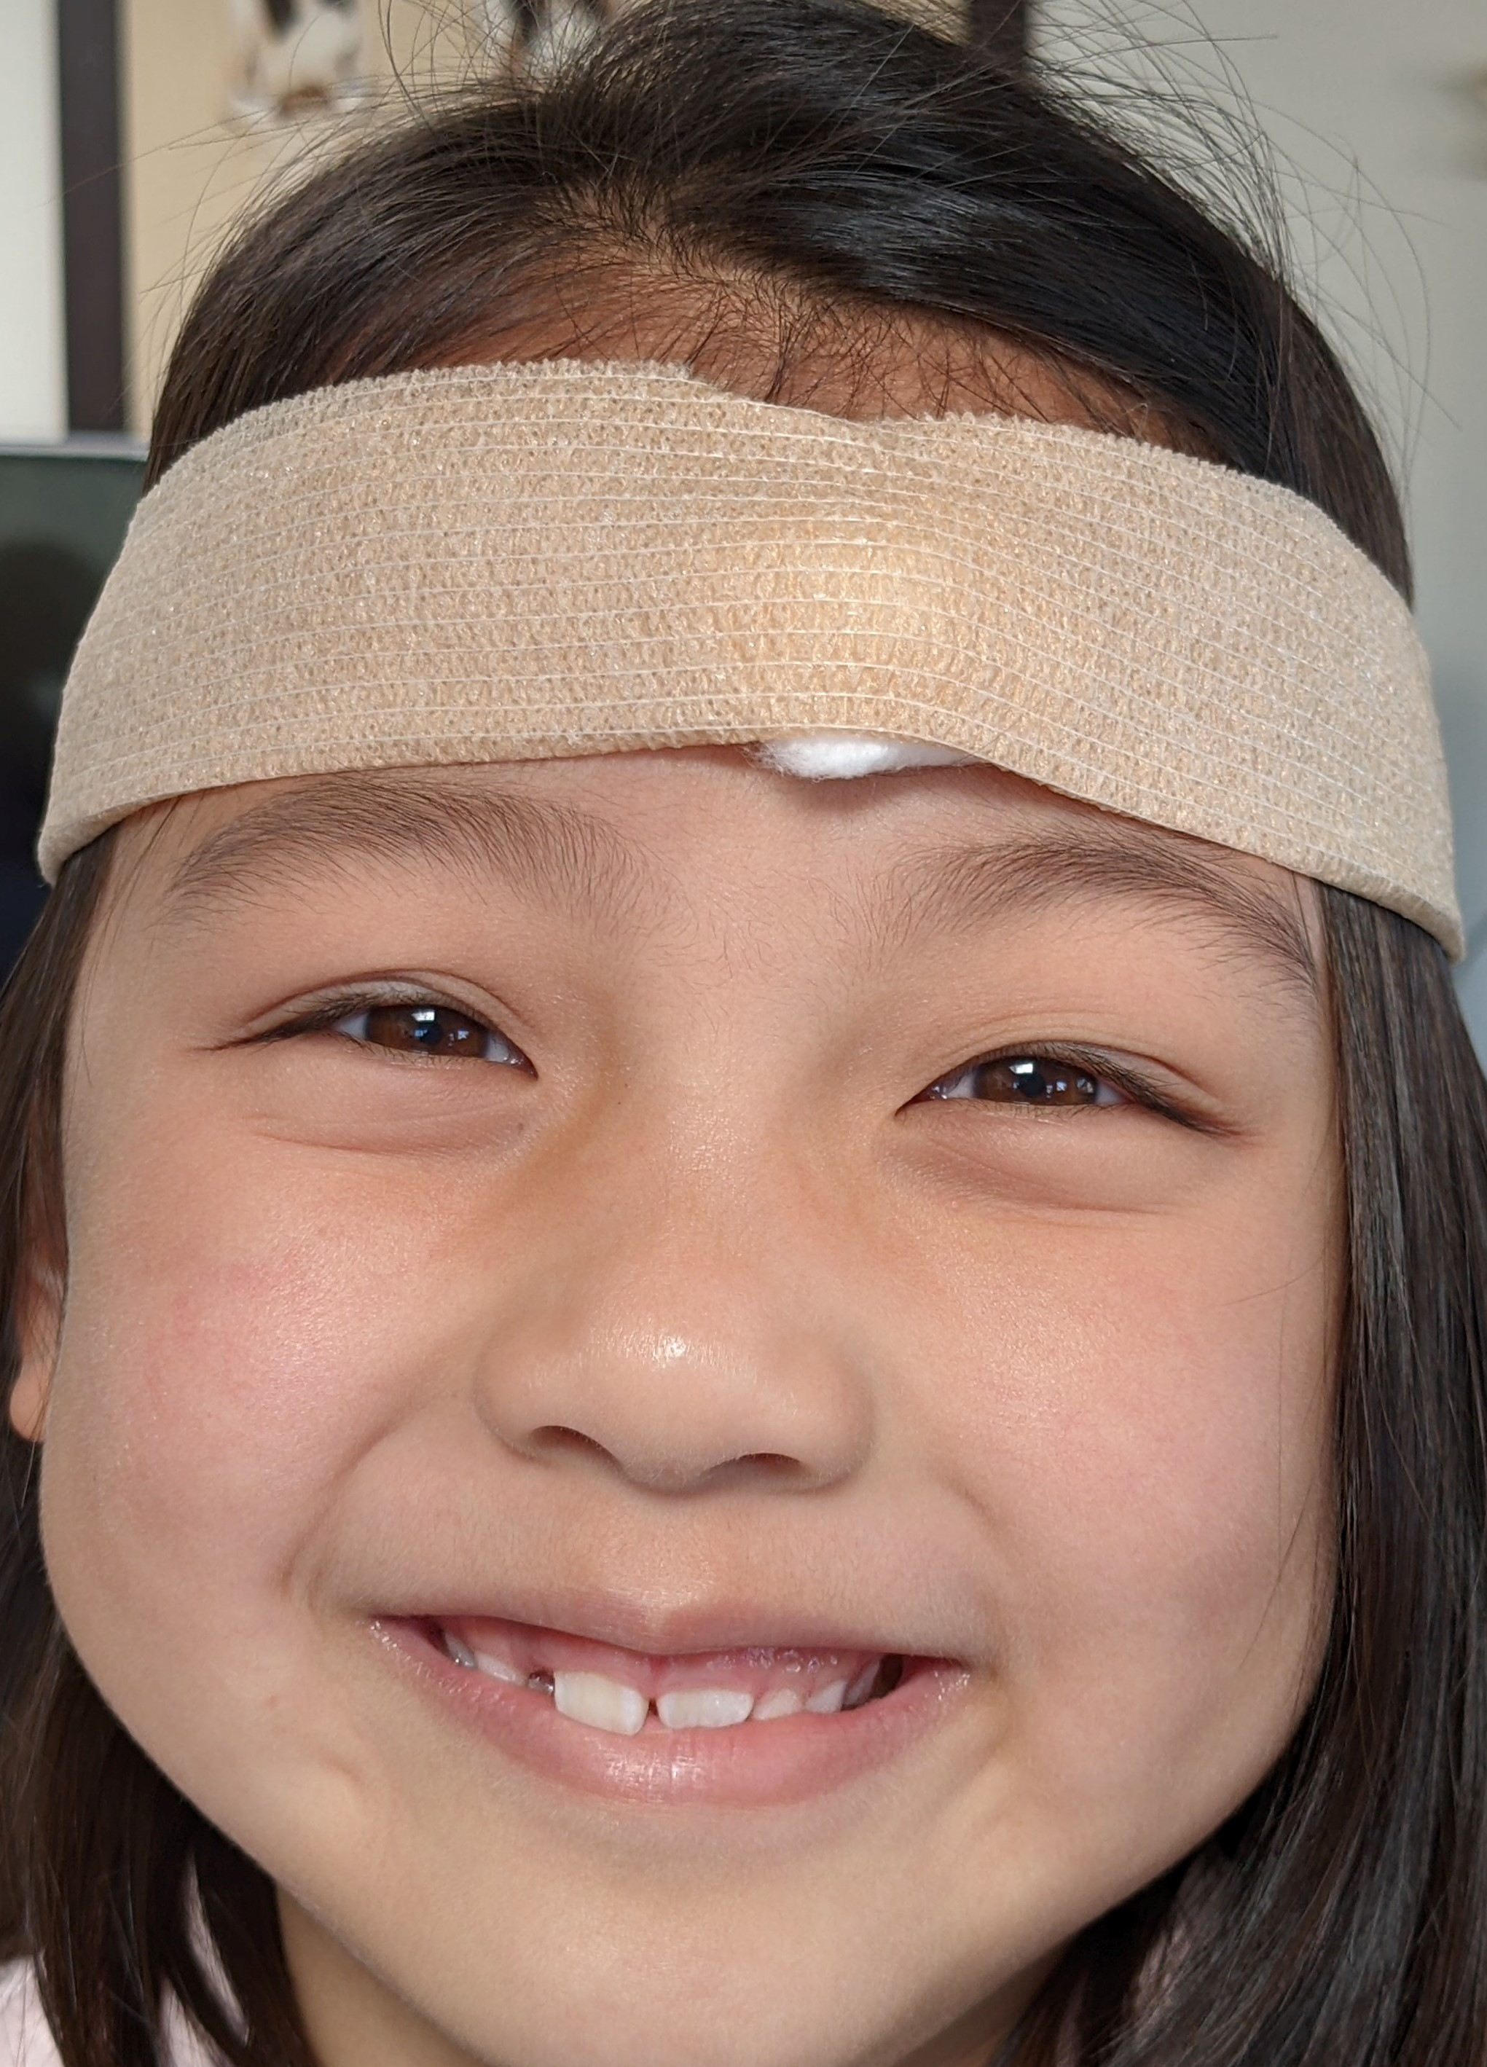
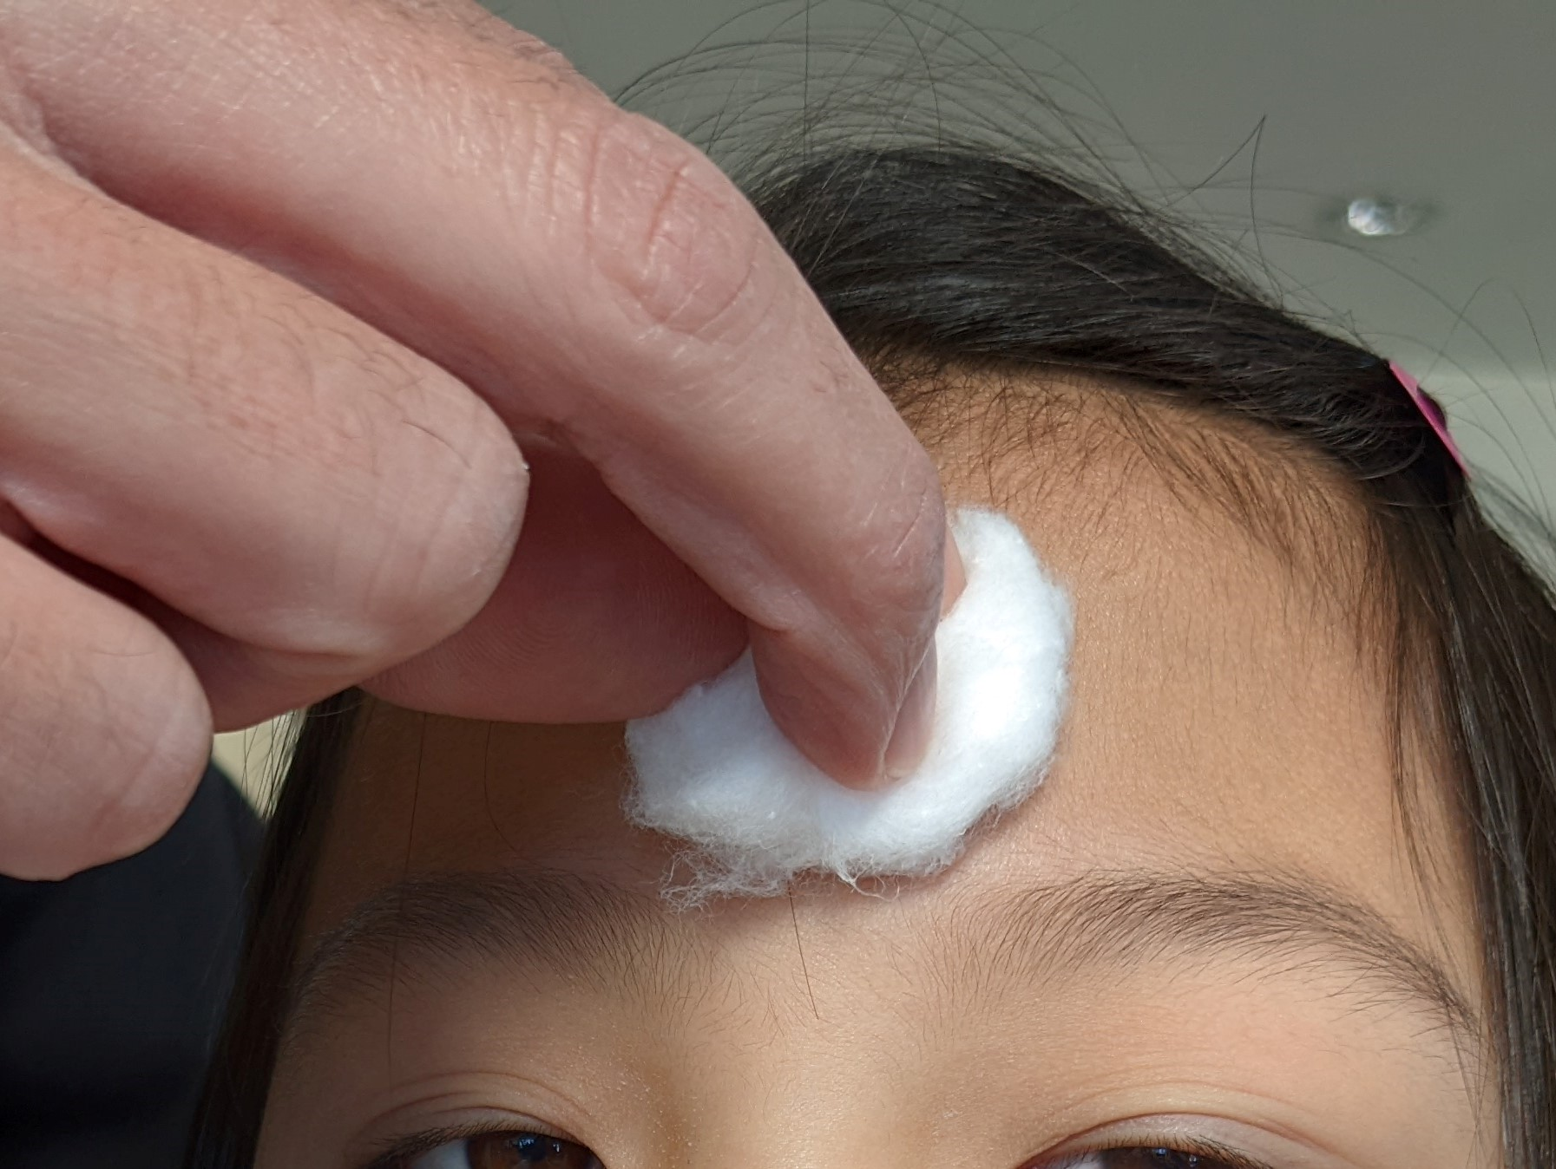
Case 2 - What did I decide?
    Preparation
Notes:
I immediately place a cotton ball soaked with LET into the wound and apply pressure by wrapping co-ban around the child’s head to keep it in place, as shown in the photos.

Slide 22
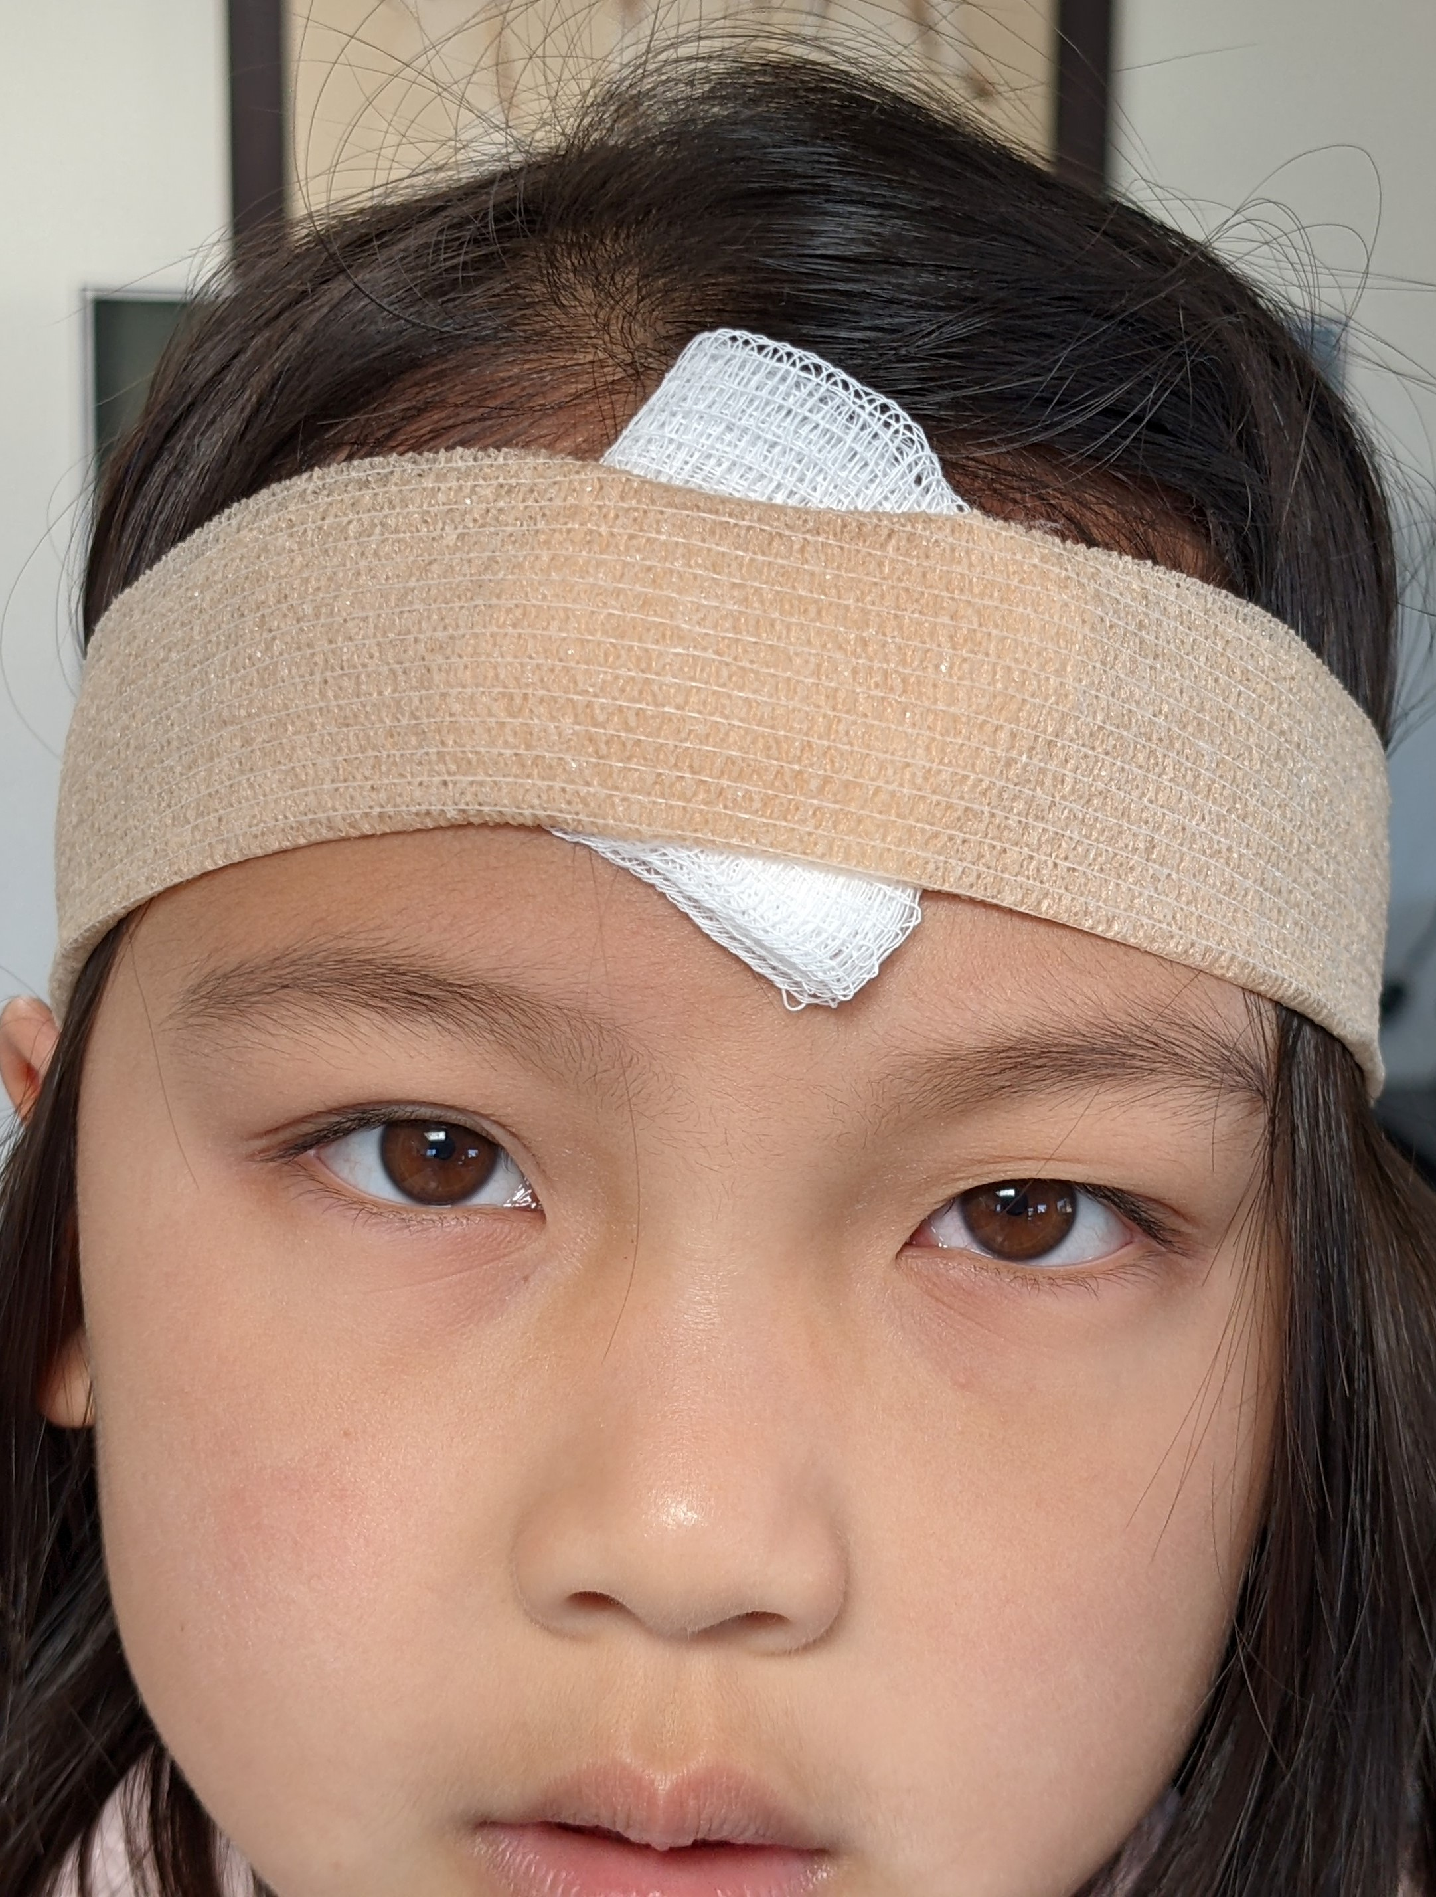
Case 2 - What did I decide? – PRO TIP
Notes:
PRO TIP:
It is very important to remember that LET will not absorb into the wound, and thereby will not work, if you use a gauze. You must use a cotton ball and a pressure dressing to ensure that the medication is able to be well-absorbed.
The child seemed very anxious during my initial examination so I also discussed using intranasal midazolam for anxiolysis, to which the mother agrees.

Slide 23
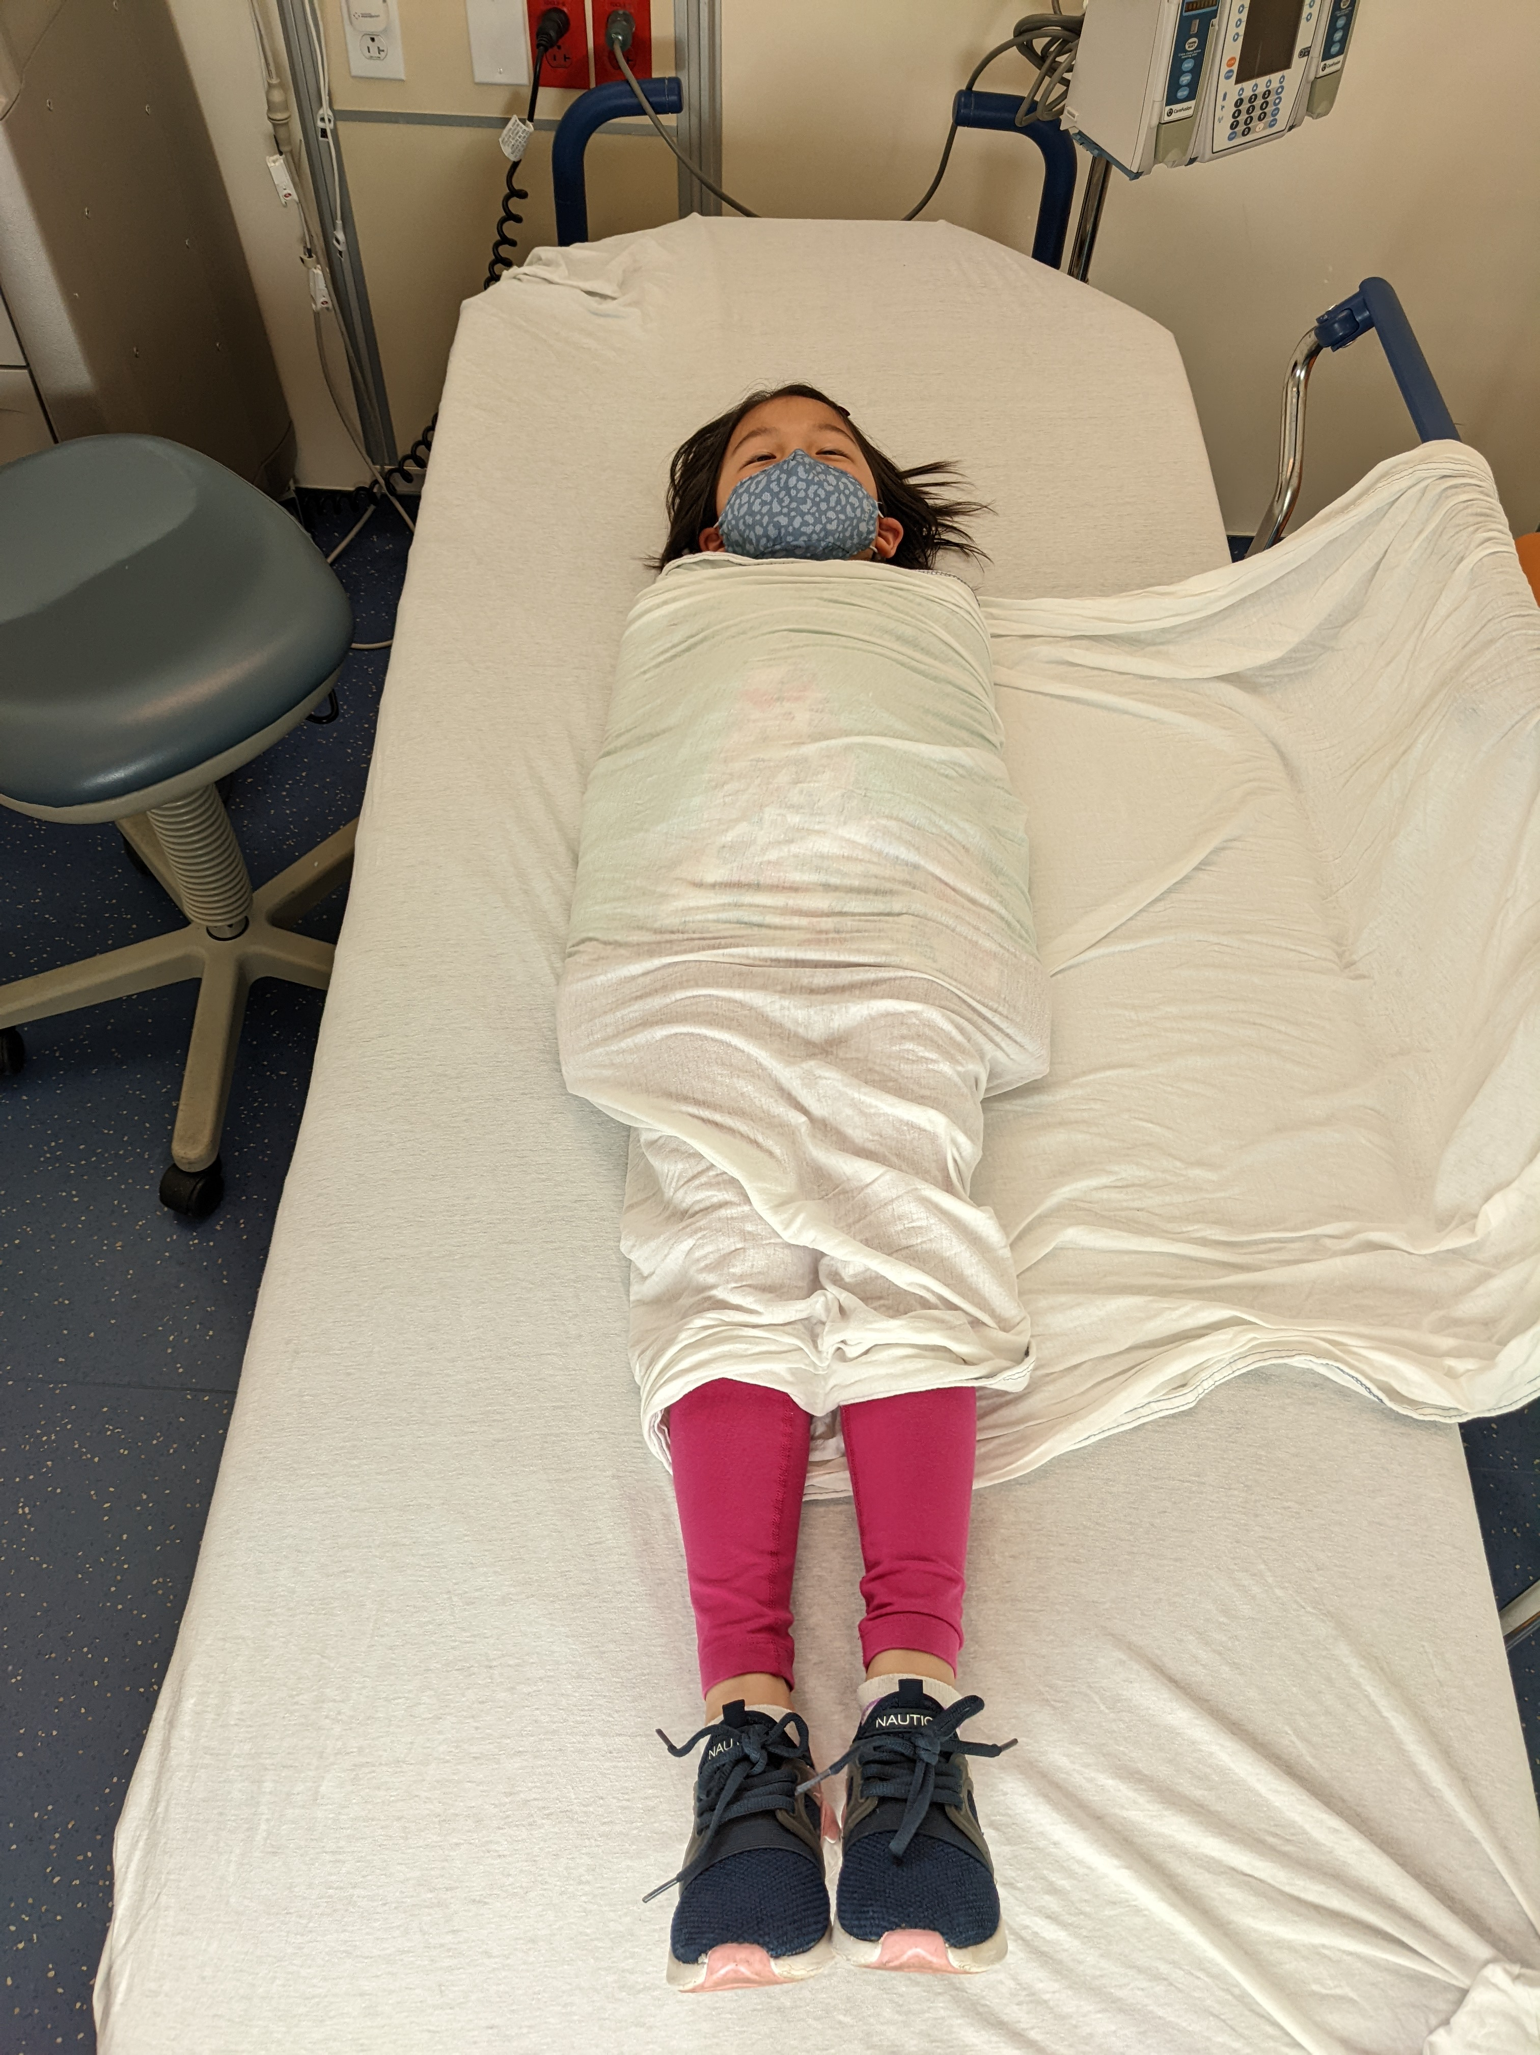
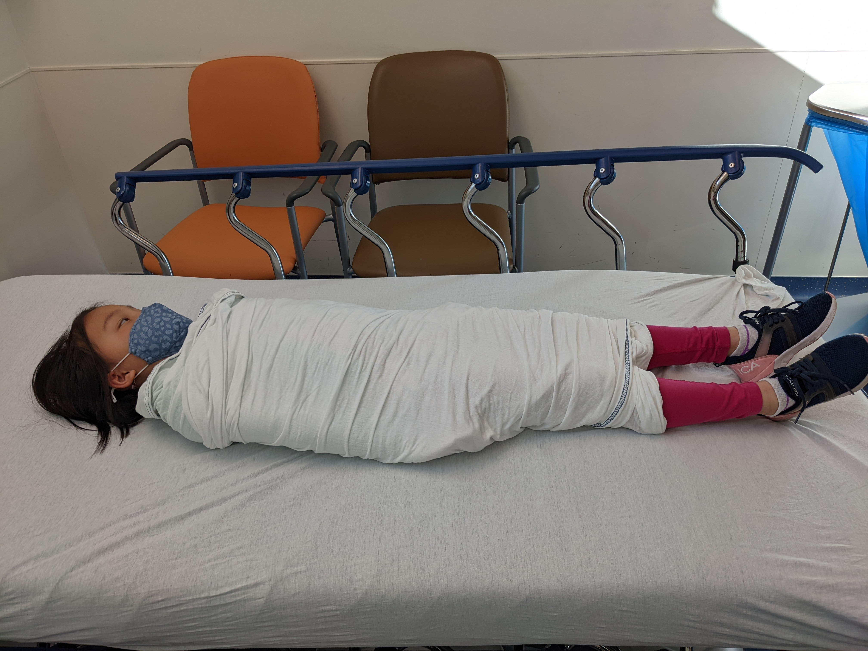
Case 2 - What did you decide?
    Preparation
Notes:
Unfortunately, even after a healthy dose of midazolam, the child is combative and the mother has a difficult time holding them securely.
I decide to wrap the child in a bedsheet so that they can be held more safely.
From these photos you can see that it’s important to first secure one edge of the sheet underneath the child before wrapping the opposite edge; this allows for a more secure hold and easier control.

Slide 24
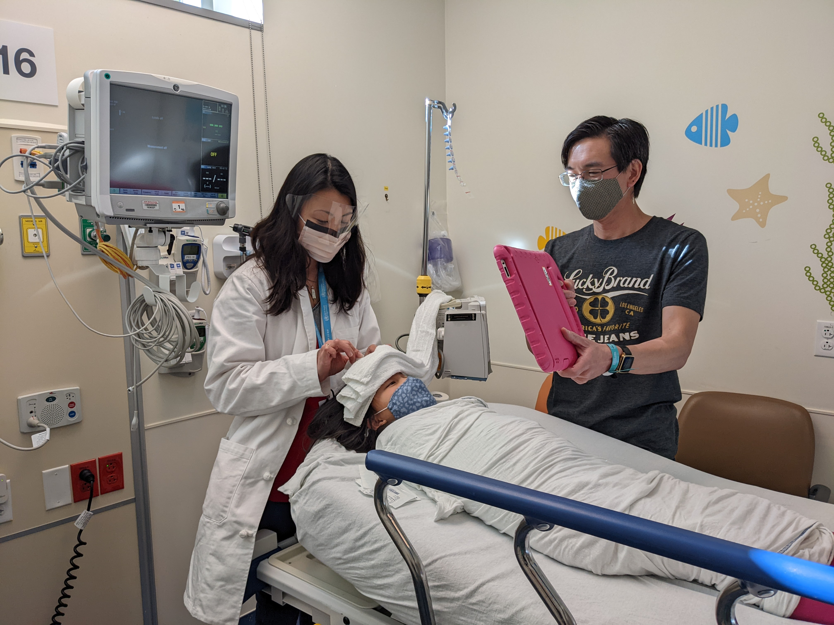
Case 2 - What did I decide?
    Go time
Notes:
Now it’s time to begin. I set up your field so that the child is not able to easily watch you perform the repair, which will reduce additional anxiety. As you can see in the photo, by standing over the head of the bed to repair a forehead laceration, I am not fully in the patient’s view. In addition, using a screen such as an iPad playing a favorite video or game provides further distraction from my work.
Finally, if you are able to hang up a towel or have an additional staff member hold up a towel, this will completely obstruct the child’s view.
Congratulations, you are able to successfully complete the laceration repair without any complications!

Slide 25
Summary
Assess a child’s pain level.
Maximize the use of non-pharmacologic pain control techniques.
  Comfort holds
  Distraction
  Positioning
Topical anesthetics can be very effective.
A combination of non-pharmacologic and pharmacologic interventions is key.
Notes:
Don’t forget to assess a child’s pain level so that you can properly address it.
Anxiety often contributes to pain.
Maximize the use of non-pharmacologic pain control techniques.
Comfort holds and close parental contact
Distraction (e.g., Buzzy Bee, tablets)
Positioning to decrease visual cues
Topical anesthetics can be used effectively with preparation.
A combination of non-pharmacologic and pharmacologic interventions is often needed to complete painful procedures in children.

